Slide 1
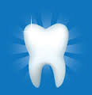

YOUR TEETH AND HOW TO KEEP THEM
HEALTHY!
GOT DENTAL SEALANTS?
Kathy Stinely, BSN, RN
Notes:
I want to talk with you for a few minutes today about your teeth and how to keep them healthy. We will also be talking about the dental sealant program here at school that is one way to keep from getting cavities.

Slide 2
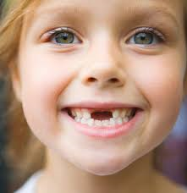
BASIC INFO
Primary (baby) teeth
  Chewing
  Pronounce words
  Placeholders for permanent teeth
  Start losing around age 6 years
Permanent (adult) teeth
  First permanent molar age 6-7 years
  3rd molar or wisdom teeth age 17-21 years
  ONCE YOU GET YOUR PERMANENT TEETH, YOU DON’T GET ANOTHER SET
Notes:
Your teeth are pretty much the only thing in your body that you get two sets of. Your primary teeth came in when you were a baby. They allow you to chew and start eating solid food. They are also necessary for proper speech and are placeholders for where your permanent teeth will come in. You had 20 primary teeth, 10 upper and 10 lower. You probably remember loosing your first tooth. Most kids start loosing them around age 6. You get your first permanent molar around age 7. The final teeth to come in are your third molars or wisdom teeth around age 17-21 years. Remember, once you get your permanent teeth that’s it. You need to care for them so they will last for the rest of your life.

Slide 3
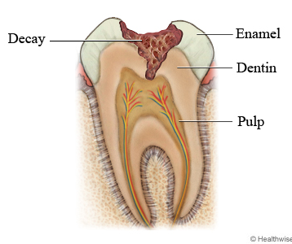
WHAT CAUSES CAVITIES?
Tooth decay is the number one chronic infectious disease in American children.
Dental health is closely related to your general health.
Relationship between poor dental health/gum disease and health problems like heart disease and stroke.
Sugary and high carbohydrate foods and drink react with bacteria in your mouth to form plaque.
The acids in plaque eat away at tooth enamel.
Hole in tooth = cavity
Notes:
Tooth decay is the number one chronic meaning long term, infectious (caused by bacteria) disease in American children. We’ve also learned that dental health doesn’t just affect your teeth. Research has found relationships between poor dental health and problems like heart disease and stroke.
Tooth decay or cavities are caused by plaque, a smooth sticky substance that forms on your teeth and gums. You can feel plaque on your teeth by running your tongue over your teeth when you get up in the morning. Then brush your teeth and feel. After brushing, your teeth feel smoother. The coarse feeling was plague that you have removed. Plaque contains bacteria that feed on the sugars in the food you eat. As the bacteria feed, they make acids. Over time the acids attacks the hard enamel covering your teeth and eat their way through to the soft dentin below creating cavities. Cavities are treated with fillings by a dentist. If left untreated, the tooth can become infected or so damaged it must be pulled.

Slide 4



FOODS TO AVOID
Limit intake of sugary drinks
  Carbonated drinks/sodas
  Sports drinks
  Fruit juices
Foods high in carbohydrates or sugar
  Candy
  Pasta, rice, flour, potato, fruit
GOAL: Healthy balanced diet
Notes:
So if foods and drinks high in sugar react with the bacteria in your mouth to form the acid that damages your teeth it makes sense to limit these items. Sports drinks and fruit juices along with carbonated drinks like soda all keep acid levels in your mouth high and can erode your tooth enamel. So do starchy or sugary foods. It doesn’t mean you can’t have these things in your diet in moderation; they just shouldn’t be the ONLY thing you eat.

Slide 5
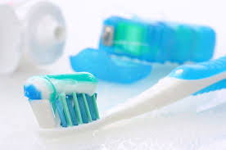
CARING FOR YOUR TEETH
Brush and floss teeth twice a day
  Take your time
  Use toothbrush labeled “soft”
  Toothpaste with fluoride
  Floss to clean between teeth
Dental Sealants
Notes:
Caring for your teeth also means working to keep them clean. This includes brushing all tooth surfaces including the tops, sides, between teeth and where the teeth and gum meet, to prevent gum disease. This is done with a soft tooth brush and fluoride toothpaste. You should brush for at least 2 minutes. To reach between your teeth you’ll need to use dental floss, also twice a day. Brushing and flossing cleans the smooth parts of your teeth and in between them. Run your tongue over your teeth. The sides are smooth and your toothbrush works great on those parts. Floss cleans between your teeth where a brush can’t reach. Now run your tongue on the top bumpy parts. Your toothbrush can’t really get into those groves. That’s where dental sealants can help.

Slide 6
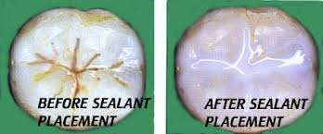
WHAT IS A DENTAL SEALANT?
Dental sealant: a thin plastic coating that's bonded into the grooves of a tooth
Creates a smooth surface on the chewing part to prevent food and plaque from being trapped.
Notes:
Dental sealants are preventative measures to help keep your teeth healthy, just like brushing and flossing. A sealant is a thin plastic or acrylic coating that is brushed onto the top bumpy parts of your teeth. It’s bonded into the groves to create a smooth surface, filling in the bumps and crevices that are normally there to prevent food particles and plaque from getting trapped, leading to cavities.

Slide 7
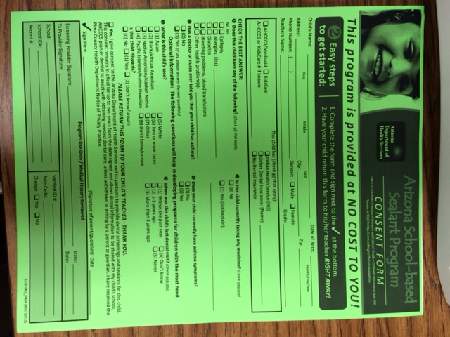
HOW CAN I GET THEM?
Pima County Health Department offers FREE dental sealants to eligible 2nd and 6th grade students
Have your parents complete the application and return it to your teacher
Write “no thanks” if you already have a dentist or sealants and return form
Notes:
The Pima County Health Department offers free sealants to 2nd and 6th grade students. Why just those grades? That’s when you get your two sets of molars (the teeth in the back of your mouth that feel bumpy on top). We want to apply sealants before those teeth have time to get cavities. Your teacher will be handing out a packet explaining the program to your parents. Please take it home for them to read. If they wish for you to be evaluated for participation, have them complete and sign the green consent form. If you already have sealants or your parents are not interested, have them write NO THANKS on the form. Either way, please bring the forms back to your teacher or the health office ASAP.

Slide 8
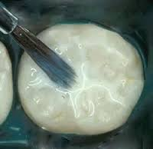

DOES IT HURT?
Sealants are applied by a dentist at school
Teeth to be sealed are cleaned
Sealant is applied with a brush
Special light activates ingredient in sealant that bonds or sticks it to the tooth
No needles, No drills, No PAIN!
Notes:
After you turn in your consent and are qualified, the dentist will come to our school in the big Pima County dental RV. You will be seen by a dentist who will check your teeth. The next visit they will apply the sealants. Your teeth will be cleaned and the sealant will be painted on with a brush. A special light will activate an ingredient in the sealant that will bond or seal it to the tooth. No needles, no drills, no pain. Not a bad way to keep from getting cavities! Please take the packet home to your parents and have them complete the green consent. Return this form to this teacher or the health office and we’ll be in touch..

